Slide 1

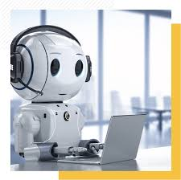
AI Chatbots – Who’s Behind The Screen?
Glenn Hills Middle School
Ms. A. New, M.Ed., Library Media Specialist
Source: Common Sense Media

Slide 2
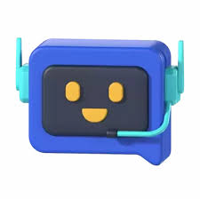
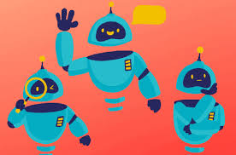
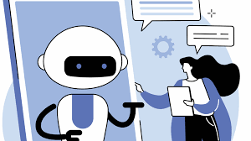
Essential Question
Why are AI chatbots designed to sound so human-like, and how can that impact our everyday lives?

Slide 3
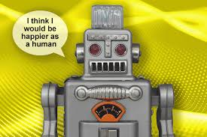
Learning Objectives
Define what AI chatbots are and how they work.
Understand why AI chatbots are intentionally designed to sound like people.
Reflect upon the potential impacts of AI chatbots in our lives.

Slide 4
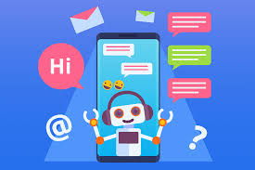
Key Vocabulary
artificial intelligence (AI) – a computer program or app that can perform tasks that typically require human intelligence
AI chatbot – a computer program or app that uses AI technology to respond to what you say in real time

Slide 5
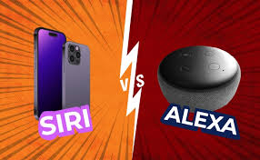
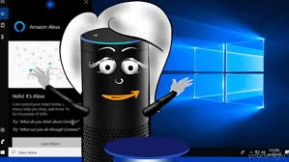
What are AI chatbots?
Have you ever interacted with Siri or Alexa, or another type of chatbot assistant?
What are other examples of AI chatbots you've come across?
What have you used AI chatbots for?

Slide 6

Artificial intelligence is a computer program or app that can perform tasks that typically require human intelligence. And an AI chatbot is a computer program or app that uses AI technology to respond to what you say in real time.
We're going to watch a video that explains why AI chatbots are designed to sound so human-like, and learn how that can impact our everyday lives.

Slide 7

Designing AI Chatbots Active Viewing Guide
Before You Watch The Video:
Copy the Designing AI Chatbots Active Viewing Guide onto your notebook paper. Complete the guide as you are watching the video, What Are AI Chatbots?

Slide 8
Designing AI Chatbots Active Viewing Guide
 | Things I Have Learned | Things That Puzzle Me, Or Questions I Still Have
Why Are AI Chatbots Designed To Sound Like People?
How Do Computer Scientists Make AI Chatbots Sound So Human-Like?
What Issues Might Arise If AI Chatbots Can Sound Just Like People?

Slide 9
Designing AI Chatbots Active Viewing Guide
Now that you know all about how AI chatbots are designed, can you tell the difference between a human and an AI chatbot? Circle one response for each question.
1. Can feel emotions: | Humans | AI Chatbots | Both
2. Needs to eat and sleep: | Humans | AI Chatbots | Both
3. Can makes mistakes: | Humans | AI Chatbots | Both
4. Can physically feel things, like hunger and pain: | Humans | AI Chatbots | Both
5. Can remember past conversations: | Humans | AI Chatbots | Both
6. Can be trained to have a specific personality: | Humans | AI Chatbots | Both
7. Can offer a hug: | Humans | AI Chatbots | Both
8. Can be available 24/7 (never needs a break): | Humans | AI Chatbots | Both
9. Can help with homework: | Humans | AI Chatbots | Both
10. Can imitate emotions, like happiness or sadness: | Humans | AI Chatbots | Both

Slide 10
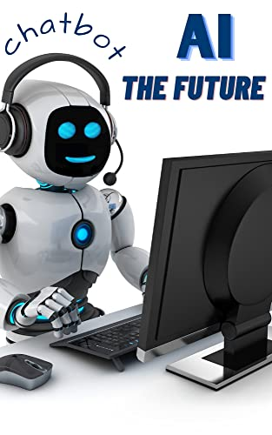

Watch The Video, What Are AI Chatbots?

Slide 11
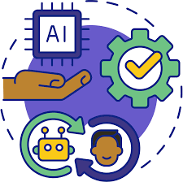
In The Know
Now that you know what AI chatbots can and can't do, it's important to consider which situations allow AI chatbots to be most helpful, and when might it be important to talk to real humans instead of talking to a machine.

